Slide 1
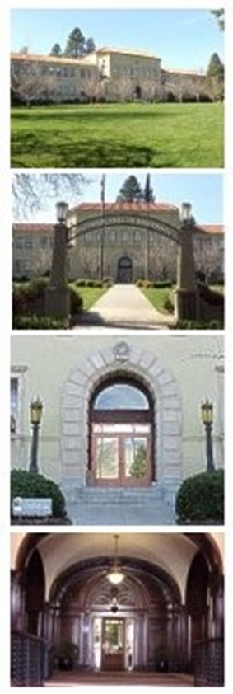
Closing of Books
Business Services
June 2024

Slide 2
Index
Overview
Information- Web Resources……….…………..03
Purpose for Closing of Books…………………..04
Definitions…………………………………………..05
Key Dates Calendar ……………………………..06
Accounting Closing of Books ……….…..…….07
Detail of Cut-off Dates……………………………..08
Expenses..…………….............09-15
Income .…….………………..….16-18
Journal……………..…………….19
Unrelated Business Income (Taxable)…......20
Campus input……………………………………...25
Contacts…………………………………..………...26

Slide 3
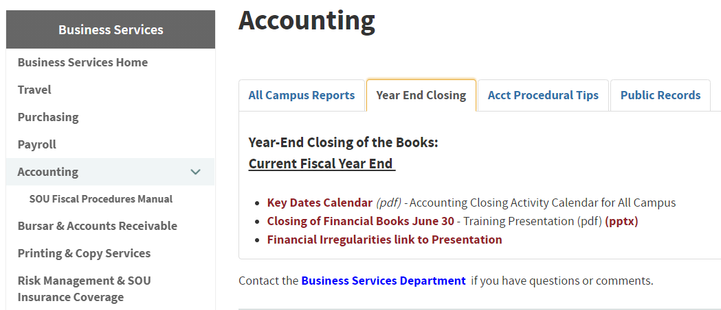
Information Resources
Business Services Website
https://inside.sou.edu/bus-serv/accounting/index.html#year-end-closing

Slide 4
Purpose
CLOSING OF BOOKS
Ensures accounting records are complete and accurate.
Ensures revenues and expenditures are reported in the correct and appropriate periods.
Provides timely data for:
1) Compilation of the University’s “SOU Annual Financial Report”
2) Inclusion in State of Oregon’s “Annual Comprehensive Financial Report”

Slide 5
Definitions
Fiscal Year The financial year is the date range of: July 1 – June 30. The fiscal year has 12 periods.
Fiscal Period The fiscal year begins in July, period 01, and ends June, period 12
Adjusting Accounting Entries
Record liabilities and receivables in the correct period.
Prepaid Expense Recording of money paid out in the current fiscal year for goods and services that will be received in the next fiscal year. Example: Theatre production; Subscriptions
Deferred Revenue Monies received in advance for products or services that are going to be performed in the next fiscal year (as revenue not yet earned). Example: Tuition or non-refundable deposits for conferences

Slide 6
Key Dates Calendar https://inside.sou.edu/bus-serv/accounting/index.html#year-end-closing

Slide 7
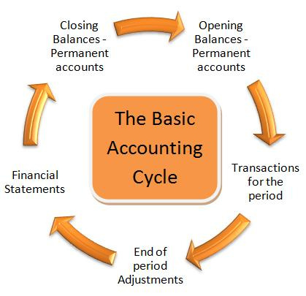
Accounting Closing of the Books
Period 12 close
JULY 8th in progress
Period 12 close
JULY 22nd

Slide 8
Detail Explanation of Cut-off Dates: Expense Income Journal
1) Purchase Orders Fixed Assets
2) Procurement Expense
3) Payroll Obligations
4) Higher One Student Reimbursement
5) Travel Reimbursement Reports
6) Expense Invoices for current year input
7) Procurement Card clearing
8) Cash Deposits
9) Student (SIS) Accounts shut-off
10) Revenue Receivable: Donation Pledges
11) Overdrawn Accounts
12) Journal Voucher Cut –off
13) Unrelated Business Income (UBI)

Slide 9
Purchases Fixed Assets
Fixed Assets must be booked prior to fiscal year end for items received on or before June 30.
Fixed Assets cannot be booked during month of July (until reconciled and balanced)
Fixed Asset module stays open but we cannot balance if invoices are entered

Slide 10
Expense Cut-off Dates
Purchase Orders for current year must be approved by Budget authority and submitted to Purchasing by June 10th
Purchases to be included in FY2024 should be completed by June 14^{th*}
Invoices must be entered and approved (10 AM) on July 5th
*Note: “Current” Fiscal Year includes Goods and Services received by June 30th

Slide 11
Payroll
By June 28th, all payroll accounting adjustments (re-distributions) for JUNE payroll must be received in the Payroll Office
July 1st is hard deadline for all payroll adjustments
Payroll external transmission of adjustments is July 5th and must include all fiscal year accounting adjustments

Slide 12
Human Resources Student Jobs & Time-Entry Form: https://southernoregonuniversity.formstack.com/forms/2024_2025_student_employee_reappointment_form
For students working after June 12th:
HR requires: “Student Employment Re-appointment Form” for student working pay period 6/13-7/12 & beyond*
For a student job ending June 12th:
Student: “Time-Entry” & submission” by 6/13 deadline
Supervisor: “Time Approval” by deadline
Refer to HR email sent 6.10.2024
*Note: For student jobs beyond date of 6/13, payroll is booked to the next fiscal year

Slide 13
Higher One Reimbursements
Requests for reimbursements to students should be to Service Center by June 24th
Fully completed Higher One documentation should be received in the Service Center by 5pm Monday June 24th
Final student reimbursement for June is submitted to Bursar and done on Wednesday same week
Note: All Higher One reimbursements are paid to students via Bank Mobile each Wednesday

Slide 14
Travel Cut-off dates
Expenses are posted to the fiscal year in which SOU receives the goods or services.
By June 28th, submit approved and completed “Travel Reimbursement Request” form for all travel completed through June 30^{th*}
*Note: To match revenues to expense in the current fiscal year, we cannot “receive” goods or services in this fiscal year and then post the expense to next fiscal year, which is next year’s budget. It does not match up.

Slide 15
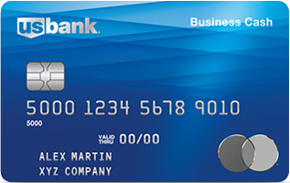
Purchasing- Card Deadlines
P-Card “use” cut-off is June 17th
(to guarantee goods will be received and expensed in this fiscal year)
P-Card closes June 26th Items not on this statement-drop are expensed to next fiscal year.*
P-Card custodian completes Transaction verifications and Cost Allocations by 5pm July 1st
* Note: Items Purchased on P-card between 6/29-6/30 will go into next fiscal year

Slide 16
Cash Deposits
Cash Deposits to Bursar:
#1 All Deposits should be delivered to Bursar Office by noon on June 28th
#2 Bring deposits as you get them, please do not hold $
The system will be shut down on June 30th at 5:00PM for Student SIS system.
The system will re-open at start of day on July 1st*
*Note: On July 1st Divisions/Departments will be able to input changes to student accounts:
Changes will not be processed in FIS Banner until system is turned back “on”
The changes will be effective in the new fiscal year

Slide 17
Revenues & Receivables
Provide List by 7/8 of:
1) “Outstanding Donation & Gift Pledges” due directly to University as of June 30
These expected resources need to be reflected in correct fiscal year
Do not include gifts or donations made through SOU Foundation
2) “Non-Student Accounts Receivable” that are outstanding as of June 30 Other than grants

Slide 18
Overdrawn Accounts
Division/Department should work with Business Services Central to clear all deficits whenever possible.
Clear deficits before the close of period 12 on July 8th

Slide 19
Journal Voucher Input & Approvals
All period 12 Journal Voucher entries should be input and cleared out of departmental approval queues by July 19th.
This Photo by Unknown Author is licensed under CC BY-SA-NC

Slide 20
Unrelated Business Income Taxable
Tax Reporting (UBIT)
Unrelated Business Income (UBI) is income received from off-campus users (individuals or groups) that involves selling of goods or performing certain services where the university potentially competes with private businesses.
You would report Income received from programs or functions that are:
“Not substantially related to the accomplishment of the University's tax exempt purpose of Education”
Note: Does not include fundraising resources going to SOU Foundation/University- Advancement
A survey will go out by July to invite your input as part of IRS Compliance.

Slide 21
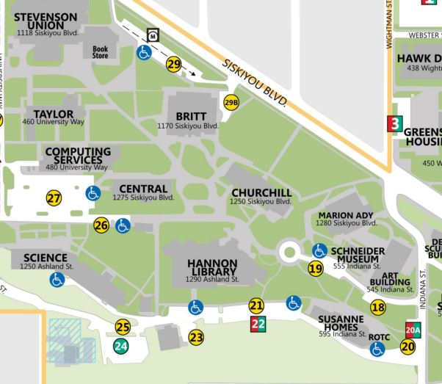
All Campus
Who needs to be trained for Closing of the Books?
Accounting/Tech Staff
Fund Managers
New or Existing Hires
Office staff
Supervisors
Directors
Questions/Comments:
Business Services Mission & Staff page
https://inside.sou.edu/bus-serv/staff.html
Agnes Maina, Director of Business Services SOU Controller
mainaa@sou.edu
Nate Allison, Deputy Controller allisonn@sou.edu

Slide 22
Contacts
Churchill Hall Location, Room 154
Business Services: sou.edu/bus-serv/
Service Center: inside.sou.edu/sc/

