Slide 1

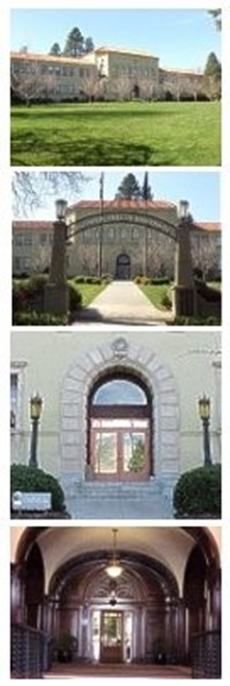
Closing of Books
Business Services
June 2026

Slide 2

Index
Overview
Information- Web Resources……….…………..03
Purpose for Closing of Books…………………..04
Definitions…………………………………………..05
Key Dates Calendar ……………………………..06
Accounting Closing of Books ……….…..…….07
Detail of Cut-off Dates……………………………..08
  Expenses..…………….............09-15
  Income .…….………………..….16-18
  Journal……………..…………….19
  Unrelated Business Income (Taxable)…......20
Campus input……………………………………...25
Contacts…………………………………..………...26

Slide 3

Information Resources for YE Closing
Business Services
https://businessservices.sou.edu/
YE Closing: Open “Tax & Tax Related”
Key Dates Calendar (pdf)
Closing of the Books Presentation (pptx)
Financial Irregularities Reporting – Go to: Internal Audit
https://businessservices.sou.edu/accounting-financial-reports/accounting-financial-reporting/#tax

Slide 4

Purpose
CLOSING OF BOOKS
Ensures accounting records are complete and accurate.
Ensures revenues and expenditures are reported in the correct and appropriate periods.
Provides timely data for:
1) Compilation of the University Annual Financial Report
2) Inclusion in State of Oregon’s Comprehensive Annual Financial Report

Slide 5
Definitions
  Fiscal Year
  The financial year is the date range of: July 1 – June 30.
  The fiscal year has 12 periods.
  Fiscal Period
  The fiscal year begins in July, period 01, and ends June, period 12
  End of Period Adjusting Entries (by accounting)
    Prepaid Expense
    Recording of money paid out in the current fiscal year for goods and services that will be received in the next fiscal year.
    Example: Theatre production; Subscriptions
    Deferred Revenue
    Monies received in advance for products or services that are going to be
    performed in the next fiscal year (as revenue not yet earned).
    Example: Tuition or non-refundable deposits for conferences

Slide 6
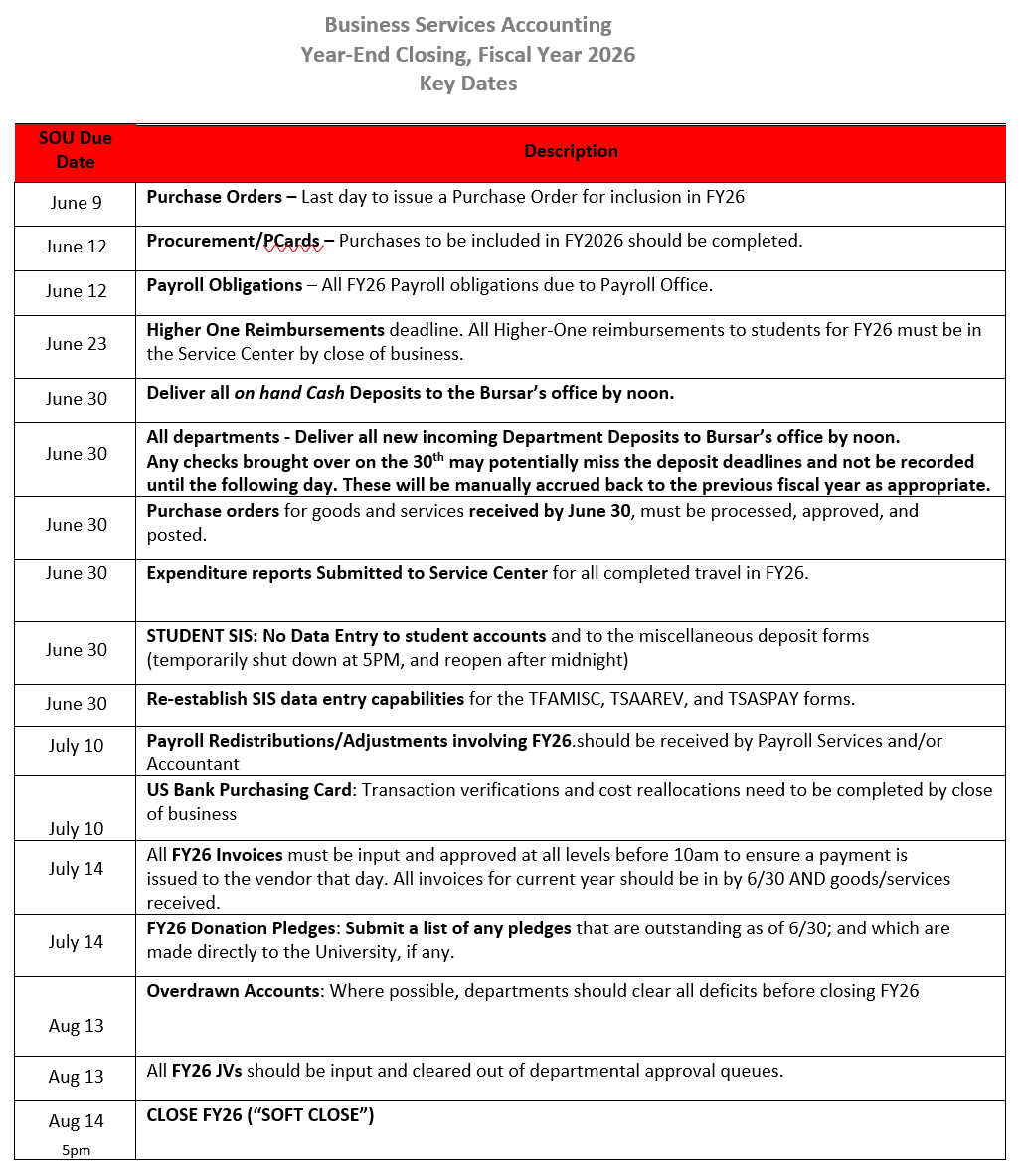
Key Dates Calendar https://businessservices.sou.edu/accounting-financial-reports/accounting-financial-reporting/#tax

Slide 7
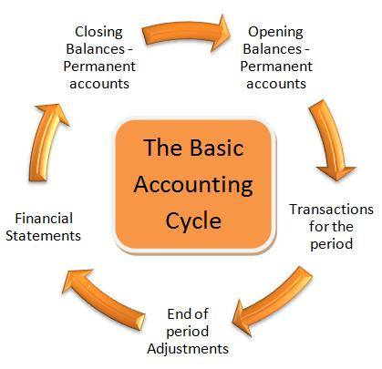
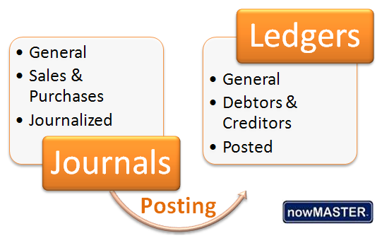
Accounting Closing Date
Close Period 12
AUG 14th

Slide 8

Detail Explanation of Cut-off Dates:
Expense
Income
Journal
1) Purchase Orders Fixed Assets / Goods & Services
2) Procurement Expense
3) Payroll Obligations
4) Higher One Student Reimbursement
5) Travel Reimbursement Reports
6) Expense Invoices for current year input
7) Procurement Card clearing (P-Card)
8) Cash Deposits
9) Student (SIS) Accounts shut-off
10) Revenue Receivable: Donation Pledges
11) Overdrawn Accounts
12) Journal Voucher Cut –off

Slide 9

Purchases
Fixed Assets
Fixed Assets must be booked prior to fiscal year end for items received on or before June 30.

Slide 10

Expense
Cut-off Dates
Purchase Orders for current year must be approved by Budget authority and submitted to Purchasing by June 9th
Purchases to be included in FY2026* should be completed by June 13th
Invoices must be entered and approved (10 AM) on July 14th
*Note: “Current” Fiscal Year includes Goods and Services received by June 30th

Slide 11

Payroll
July 10th is the hard deadline for all payroll related adjustments for JUNE payroll to be received in the Payroll Office

Slide 12

Human Resources
Student Jobs
& Time-Entry
Form: https://southernoregonuniversity.formstack.com/forms/2026_2027_student_employee_reappointment_form
For students working after June 12th:
HR requires: “Student Employment
Reappointment Form” for current students working 6/13 and into the next fiscal year.*
For a student job ending June 12th:
Student: “Time-Entry” & submission” by 6/13 deadline
Supervisor: “Time Approval”
by deadline by 6/17
Refer to HR email sent 5.14.2026
*Note: For student jobs beyond date of 6/13, payroll is booked to the next fiscal year

Slide 13

Higher One Reimbursements
Requests for reimbursements to students should be to Service Center by June 23rd
  Fully completed Higher One documentation should be received in the Service Center by 5pm Monday June 23rd
Note: All Higher One reimbursements are paid to students via Bank Mobile each Wednesday

Slide 14

Travel
Cut-off dates
Expenses are posted to the fiscal year in which SOU receives the goods or services.
By June 30th, submit approved and completed “Travel Reimbursement Reports” for for all travel completed through June 30^{th*}
*Note: To match revenues to expense in the current fiscal year, we cannot “receive” goods or services in this fiscal year and then post the expense to next fiscal year, which is next year’s budget. It does not match up.

Slide 15
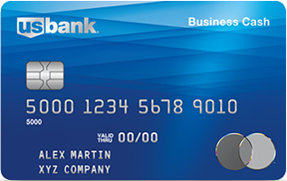
Purchasing- Card Deadlines
P-Card “use” cut-off is June 13th
(to guarantee goods will be received
and expensed in this fiscal year)
P-Card custodian completes Transaction verifications and Cost Allocations by July 10th
* Note:
Items Purchased on
P-card between 6/29-6/30 will go into next fiscal year

Slide 16

Cash Deposits
Cash Deposits to Bursar:
#1 All Deposits should be delivered to Bursar Office by noon on June 30th
#2 Bring deposits as you get them, please do not hold $
(cash or checks)
The system will be shut down on June 30th at 5:00PM for Student SIS system.
The system will re-open at start of day on July 1st*
*Note: On July 1st Divisions/Departments will be able to input changes to student accounts:
Changes will not be processed in FIS Banner until system is turned back “on”
The changes will be effective in the new fiscal year

Slide 17

Revenues & Receivables
Provide List by 7/14/26:
1) “Outstanding Donation & Gift Pledges” due directly to University as of June 30
  These expected resources need to be reflected in correct fiscal year
  Do not include gifts or donations made through SOU Foundation
2) “Non-Student Accounts Receivable” that are outstanding as of June 30
Other than grants

Slide 18

Overdrawn Accounts
Division/Department should work with Business Services Central to clear all deficits whenever possible.
Clear deficits before the close of period 12
  By Aug 13th

Slide 19

Journal Voucher
Input &
Approvals
All period 12 Journal Voucher entries should be input and cleared out of departmental approval queues by Aug 13th.
This Photo by Unknown Author is licensed under CC BY-SA-NC

Slide 20

Unrelated Business
Income
Taxable
Tax Reporting (UBIT)
Unrelated Business Income (UBI) is income received from off-campus users (individuals or groups) that involves selling of goods or performing certain services where the university potentially competes with private businesses.
Note: Reporting does not include fundraising resources going to SOU Foundation/University- Advancement
You would report Income received from programs or functions that are:
“Not substantially related to the accomplishment of the University's tax exempt purpose of Education”
A brief survey is scheduled to go out to Fund Managers and staff each year to invite your input (as part of IRS Compliance). (8 questions)

Slide 21
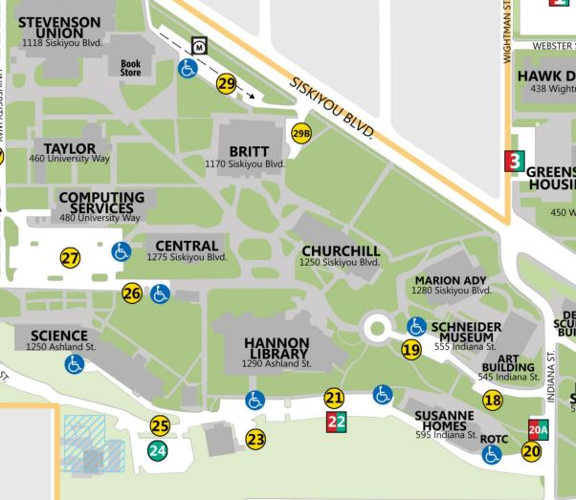
All Campus
Who needs to be trained for Closing of the Books?
  Accounting/Tech Staff
  Fund Managers
  New Hires
    Office staff
    Supervisors
Questions/Comments:
Business Services
Mission & Staff page
https://businessservices.sou.edu/contact-us/
Krista Darrah, Director of Business Services
& Controller
darrahk@sou.edu
Renee Hanna, Asst. Dir. Accounting &
Financial Reporting
hannar@sou.edu
Nate Allison, Deputy Controller
allisonn@sou.edu

Slide 22

Contacts
Churchill Hall Location, Room 154
Business Services: sou.edu/bus-serv
Accounting & Reports . Bursar . Payroll . Service Center (Operations)

